Slide 1

Version Control System (VCS)
Bashir Ansari
23dr0040@iitism.ac.in

Slide 2


Intro to the Fundamentals of Version Control System (VCS)
o1.
Intro to Version Control System
o2.
Types of VCS: Centralized Vs Distributed
o3.
Introduction to Git
o4.
Working with GitHub
o5.
GitHub Education

Slide 3
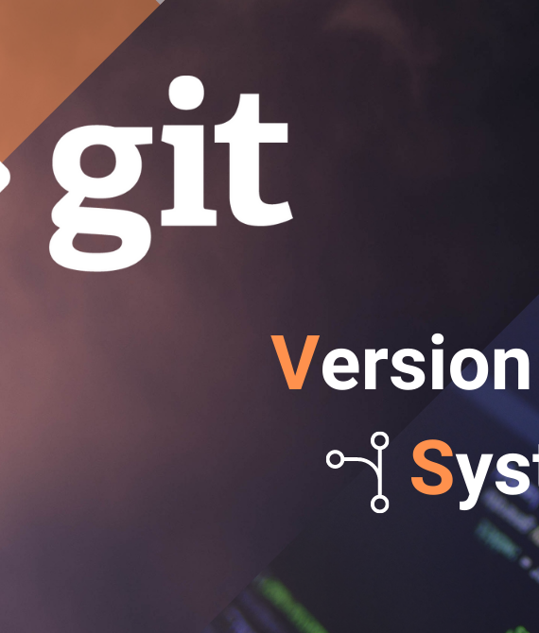
Lesson One
We will cover these skills
Overview of Version Control System
Types of VCS: Centralized Vs Distributed
Introduction to Git

Slide 4

Lesson one: Overview of VCS
Version Control refers to tracking modifications made to a file or set of files over time to retrieve a specific version later. Enables software engineers to track and manage changes in their codebase efficiently. This solution works with several developers, keeps track of changes, and makes error repair easier.
Significance:
Collaboration- VCS enables multiple developers to work on a single project concurrently. They manage the contributions of various developers, ensuring that one's work does not overwrite another’s.
Backup and Restore- Provide a backup of entire projects at various stages
Track Changes – Developers may use it to keep track of modifications, including who made them, what was altered, and why.

Slide 5
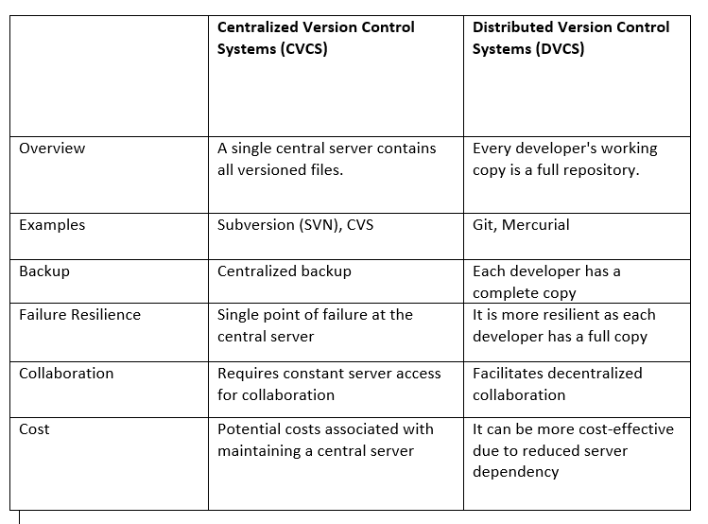
Lesson one: Types of VCS: Centralized Vs Distributed

Slide 6
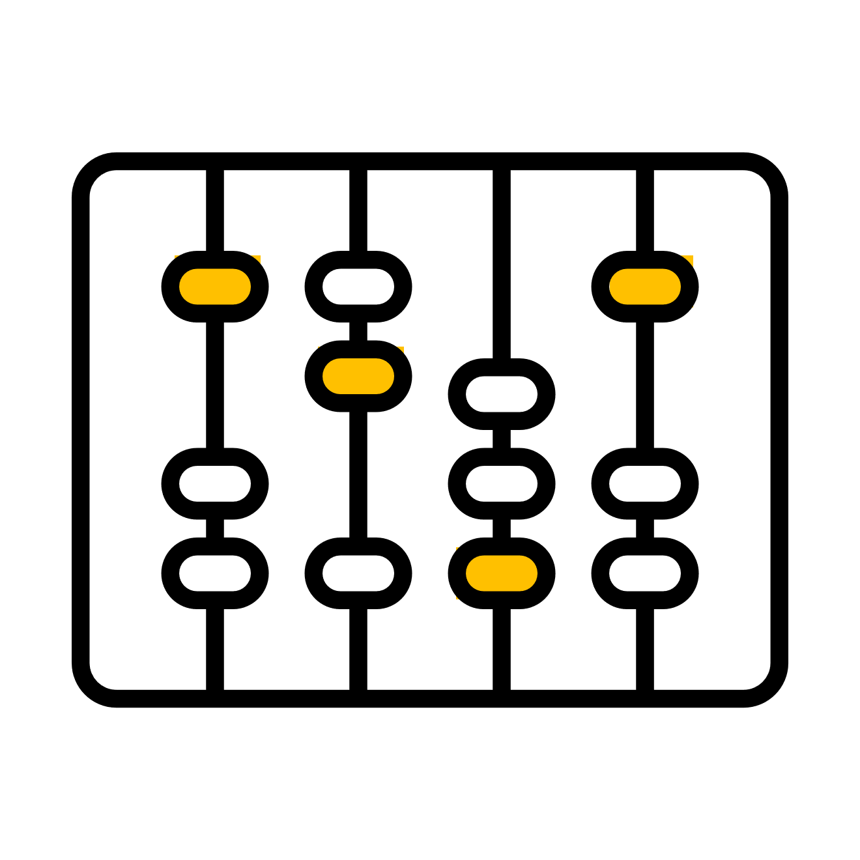

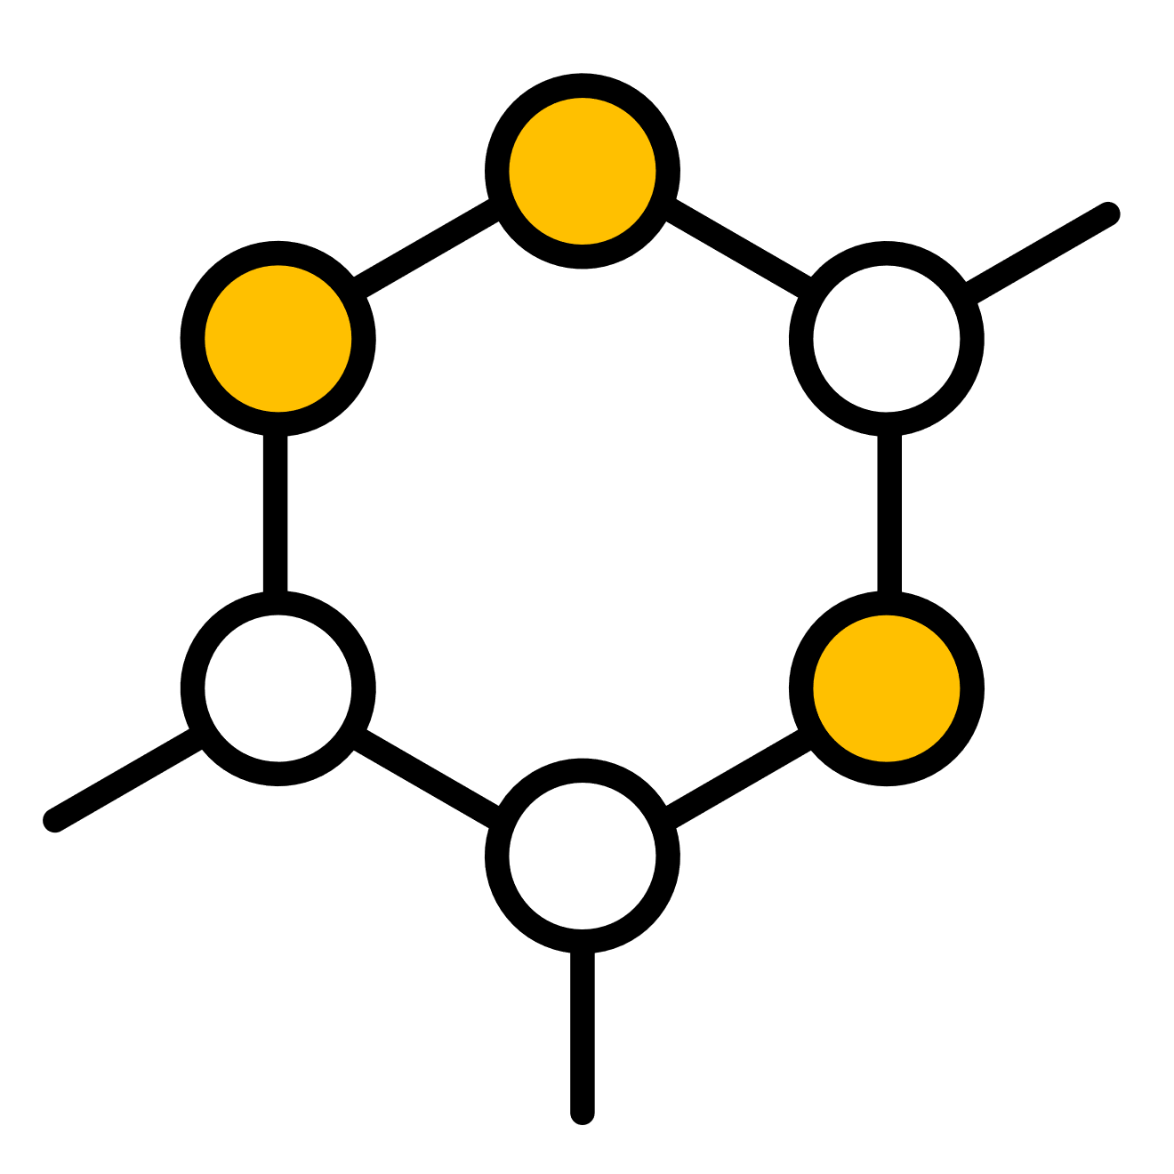
Lesson One: Introduction to Git
Overview
Git for DH
Basic Git
Git as a Distributed Version Control System
Key features and benefits of using Git in DH
Repository, Cloning a Repository, Tracking Changes

Slide 7

Lesson One: Overview
The most popular and widely used DVCS created by Linus Torvalds in 2005
With Git, Developers have access to the fully working repository that contains all the past revisions of the file. Git is fast and robust because it stores data and tracks changes in your local environment
Git records the status of the files in each commit by using snapshots rather than delta-based methods. Git only saves a link to the previous version of the file if the contents haven't changed.

Slide 8

Git for DH
Collaborative Projects
Git makes it easier for academics and students to collaborate on digital projects, exchange resources, and integrate their work.
Conservation of data
In DH projects, larger datasets-including image, audio, and video recordings- are commonly employed. Git helps maintain track of previous changes and manage these resources efficiently.
Resource Sharing and Community Engagement
In addition to hosting a Git repository, websites such as GitHub offer a community interaction area where students may submit their work, get criticism, and collaborate on the other projects.

Slide 9
Basic Concepts
Git manages and tracks file changes, allowing multiple contributors to work on a project simultaneously.
Operates locally on a user's computer, storing repositories on local machines
Git Repository?
A location on the disk where Git keeps track of all project files, history, and metadata. It enables tracking, versioning, and cooperation since it includes the complete project history, including all file modifications.
Repositories can be local (on your computer) or remote (hosted on platforms like GitHub, GitLab, etc.).

Slide 10

Working with GitHub GitHub is an online platform that hosts Git projects, repositories, and collaboration features. It is commonly used for code management and sharing, but it has also found applications in various other fields, including Digital Humanities and Research.

Slide 11
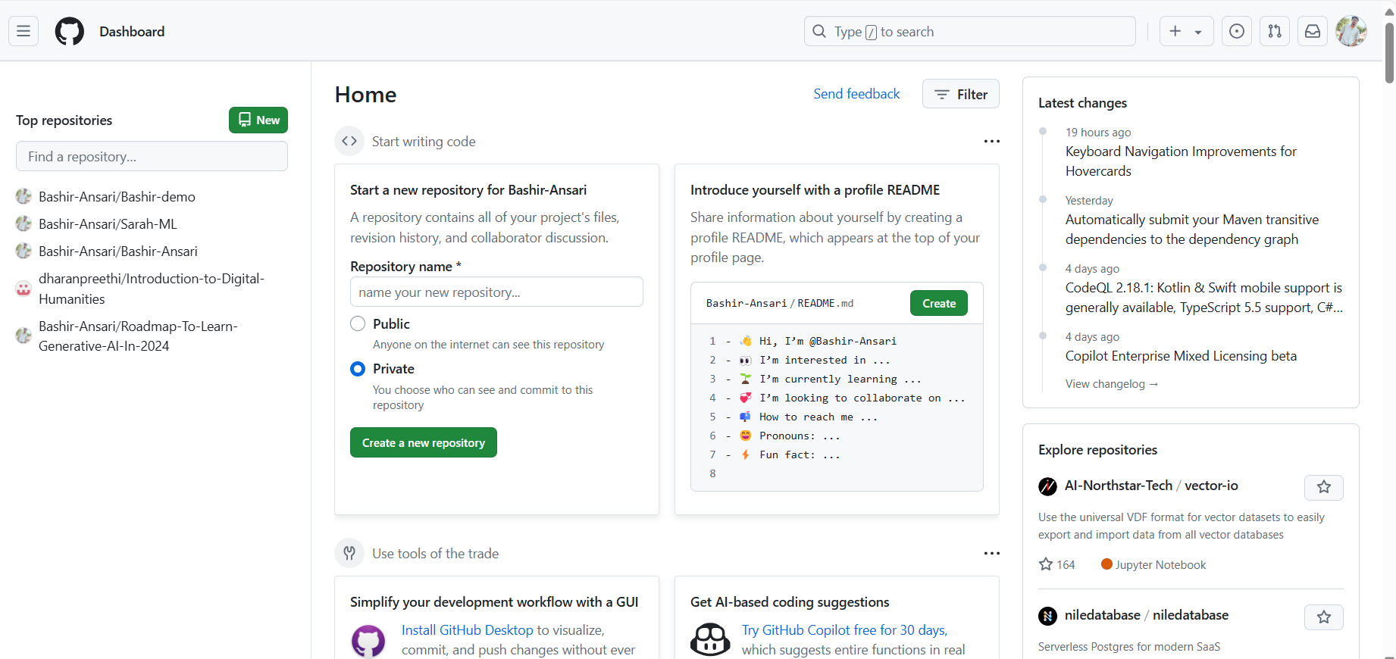
The dashboard serves as a primary landing page. It summarises your most recent activity, updates from the repository you follow, and recommendations for individuals.
Create: Helps you discover repositories, projects, and developers.
Issues: A section for tracking tasks, bugs, and feature requests. Users can create, comment on, and close issues.
Pull Request: This area shows all open pull requests, which are proposed changes to the repository. Pull requests facilitate code review and discussion before changes are merged.
GitHub: Hands-on
…………………

Slide 12

GitHub Education

Slide 13

Thank you
Please send all questions to:
23dr0040@iitism.ac.in

Slide 14

Git - Book (git-scm.com)
Git - Documentation (git-scm.com)
GitHub Foundations Certification Course – Pass the exam in 10 hours! (youtube.com)

